Slide 1
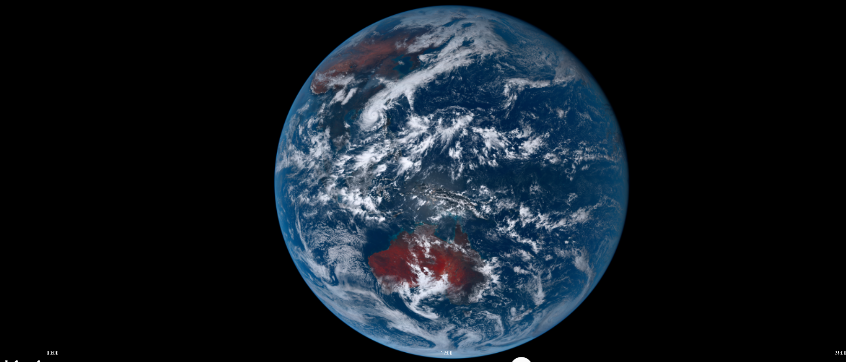
Detecting Multi-layer Cloud Systems in Himawari-8/9 Using Deep Learning
Mathilde Ritman
School of Mathematics, Monash University ARC Centre of Excellence for Climate Extremes
Caroline Poulsen, Steve Siems and Daniel Robbins

Slide 2
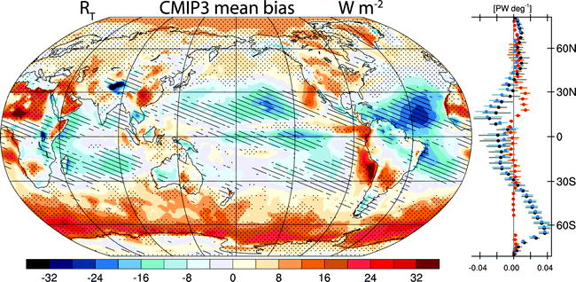
Climate models have large biases in radiation over the Southern Ocean
Trenberth et al., (2010)

Slide 3
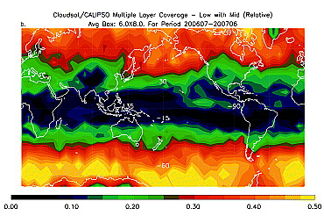
The biases are linked to the high frequency of multi-layer clouds
Mace et al., (2009)
Trenberth et al., (2010)

Slide 4

Why would multi-layer clouds cause large biases?

Slide 5

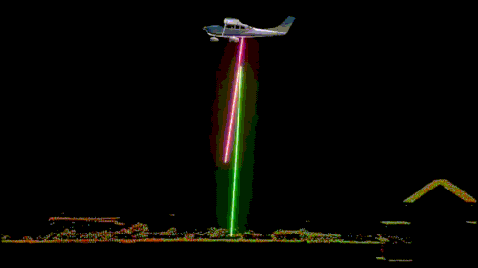
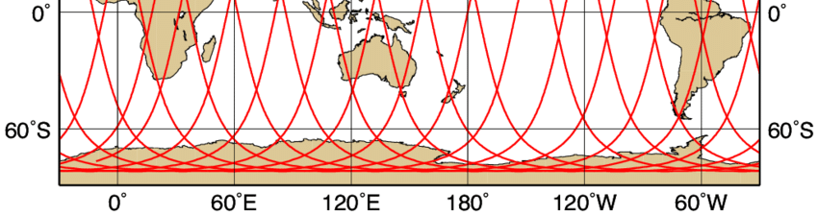
Progress is limited by poor observation
“Passive” geostationary satellites:
High frequency and spatially dense
Historically bad at identifying multi-layer cloud
“Active” polar-orbiting satellites:
Great at identifying multi-layer cloud
Spatially sparse measurements
Notes:
16 days return time

Slide 6
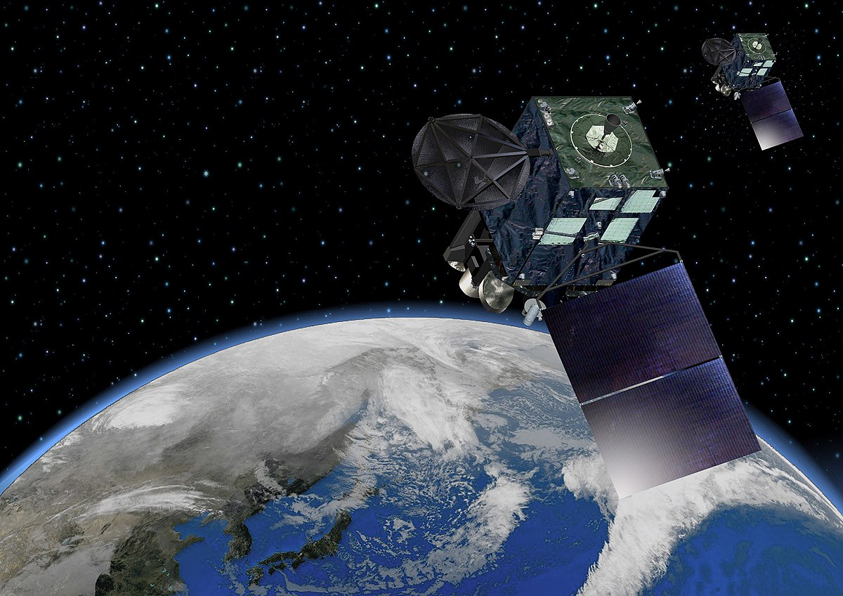
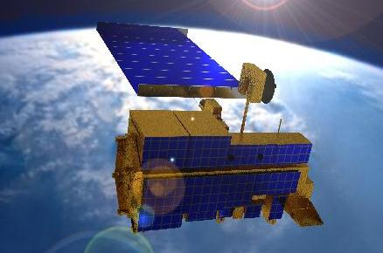
Past work
Himawari-8/9 (geostationary JMA satellite)
Machine learning (4 model types) (Tan et al., 2021):
Full field of view
70 % Probability of detection (neural network)
Neural networks (Li et al., 2022):
Full field of view
70 % Probability of detection
MODIS 6 (polar-orbiting NASA satellite)
Decision tree methods (Marchant et al., 2020):
Full globe
34 % Probability of detection

Slide 7
Project aims
Research Question: Can we use deep learning to accurately detect Southern Ocean multi-layer clouds in Himawari-8/9?
Approach:
Feed forward neural network
Convolutional neural network
Compare and interrogate using Shapley value theory (SHAP)

Slide 8
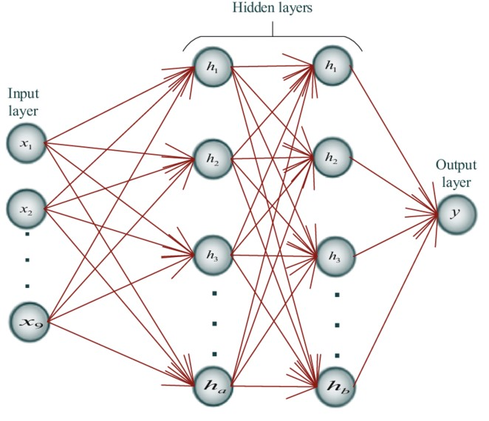
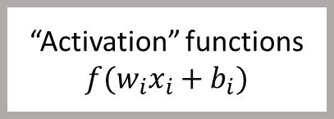
Feed forward neural networks
“Activation” functions
$$f(w_{i}x_{i}+b_{i})$$
Input data
Prediction
Minimise: difference between prediction and the “truth”

Slide 9

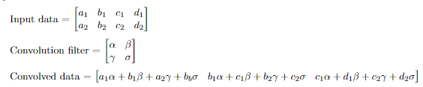
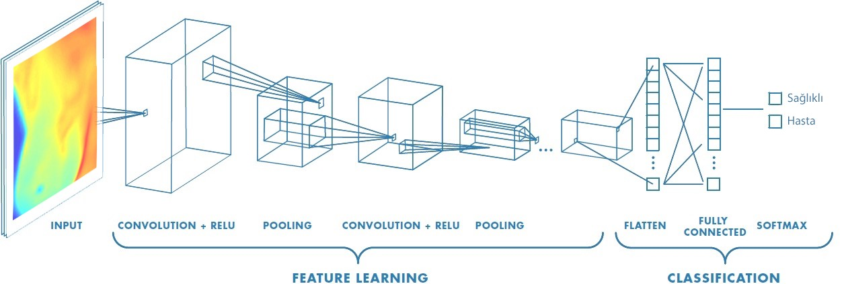
Convolutional neural networks

Slide 10
Convolutional neural networks

Slide 11
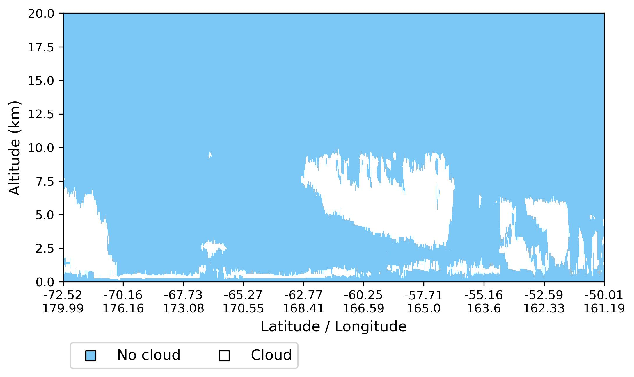
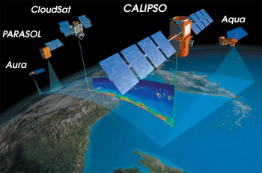
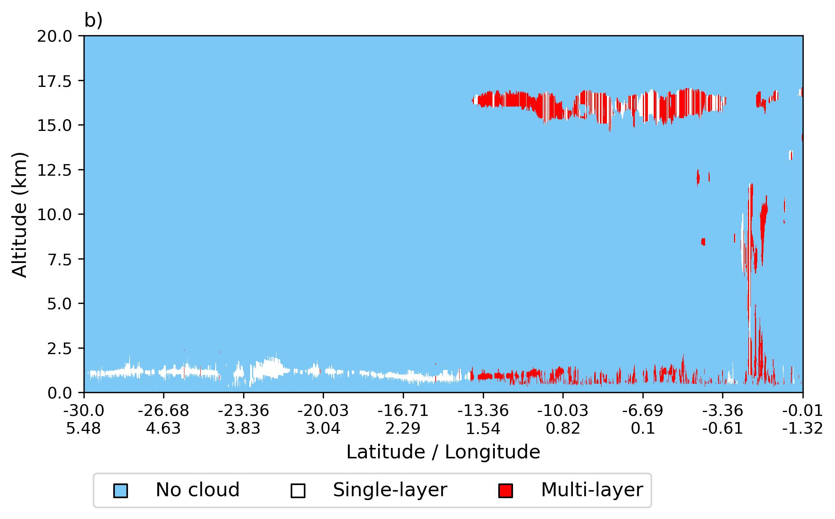
Defining the “truth”

Slide 12
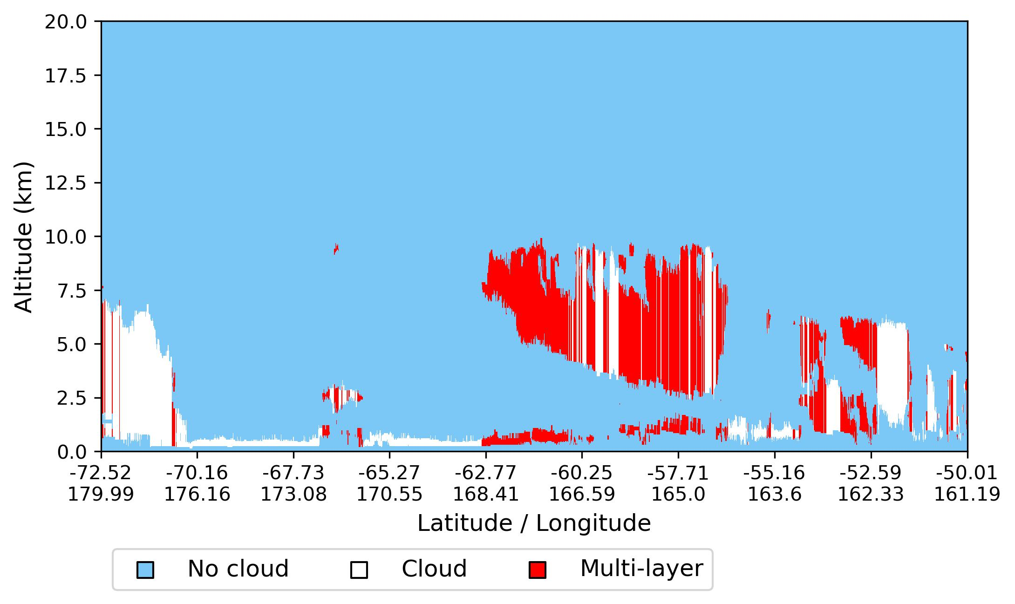
Defining the “truth”

Slide 13
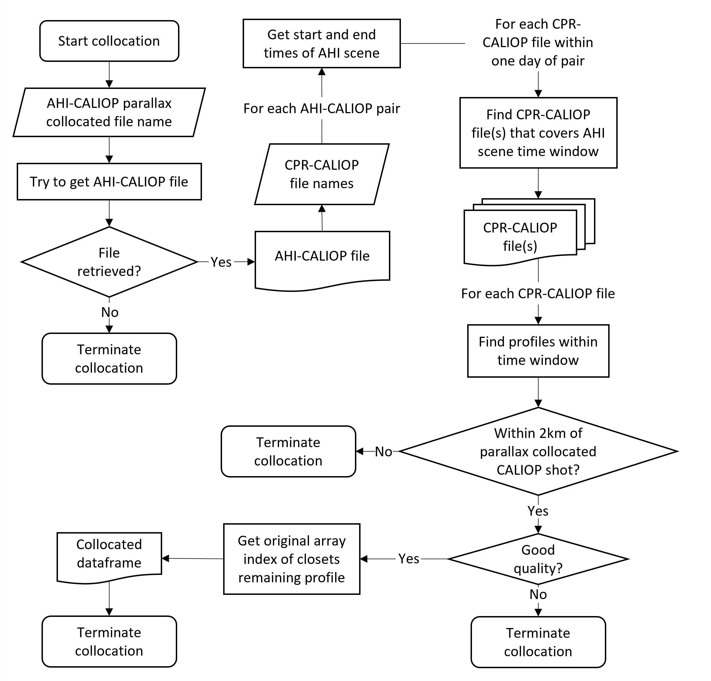
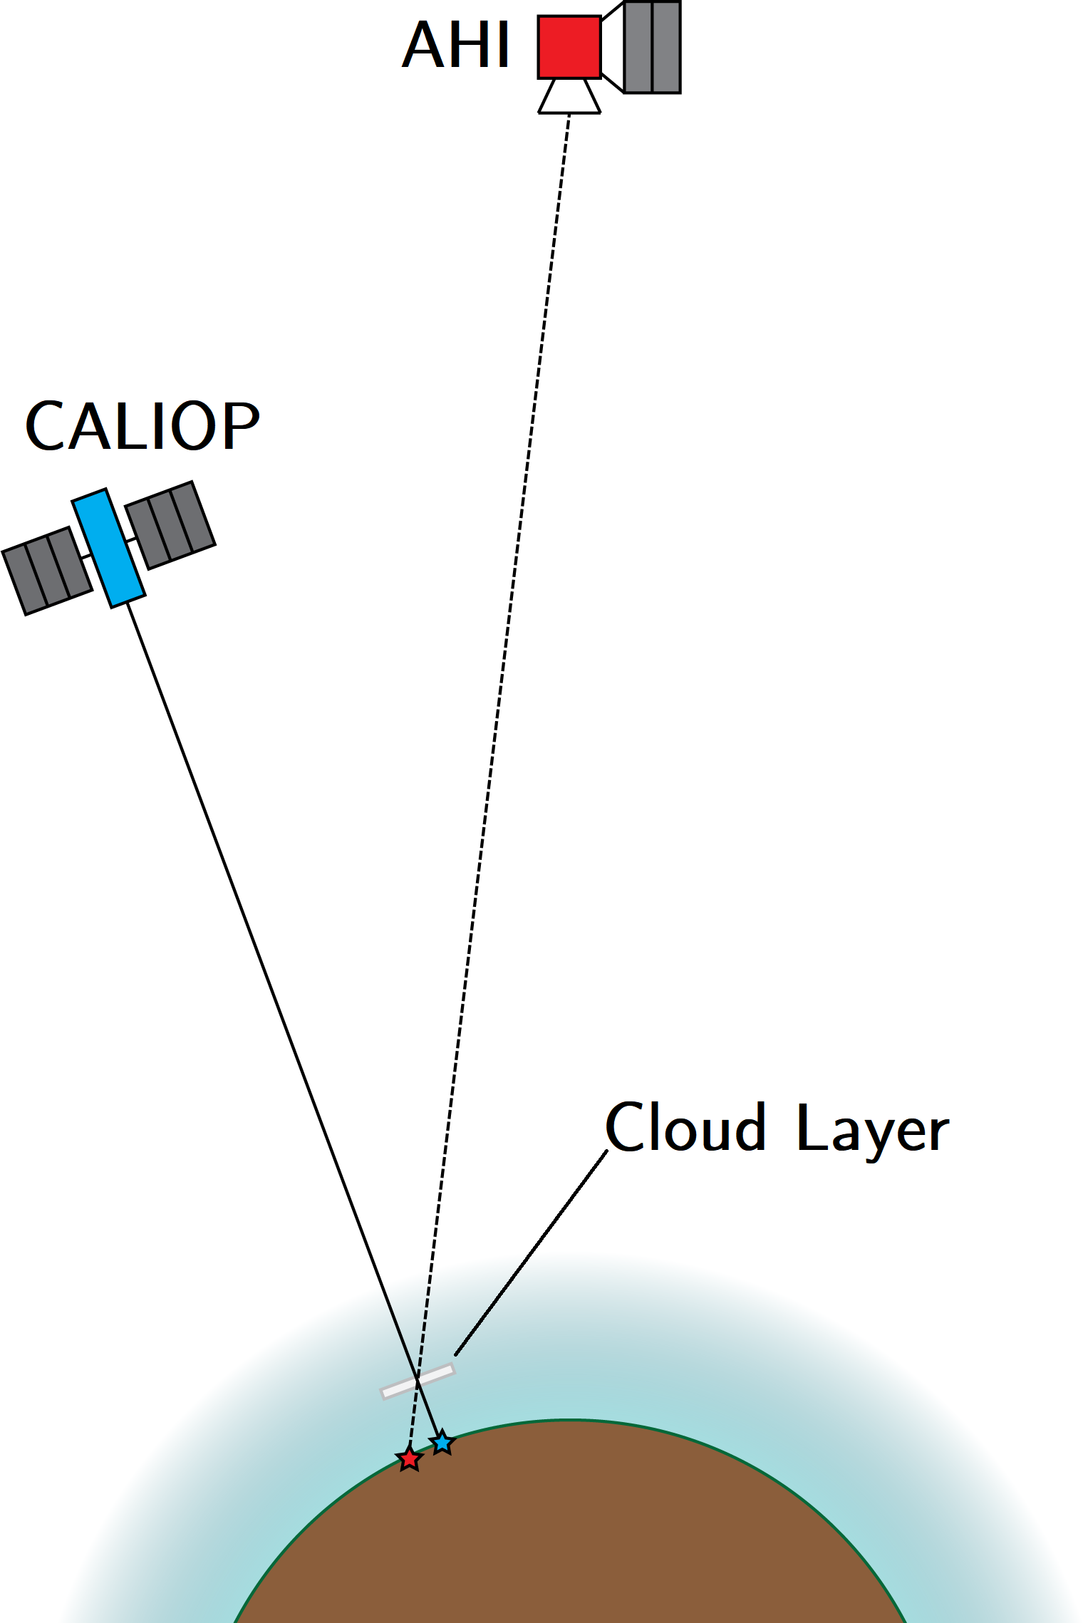
Collocating the “truth” with Himawari-8/9
~300,000 observations were collocated between Jan – Jun 2019
Robbins et al., 2022

Slide 14
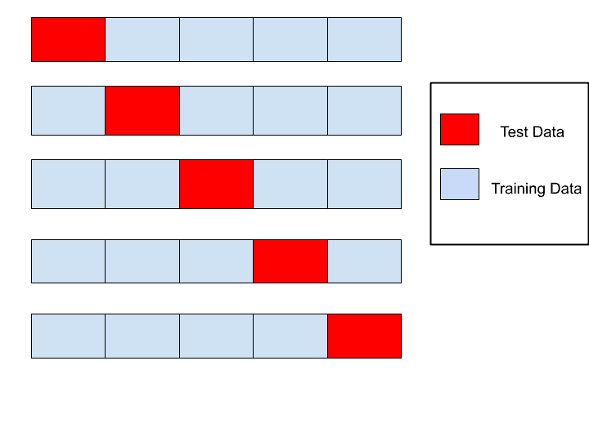
Model selection
5 layers
100 neurons
ReLu activation
Model selection process:
Split data into training and validation sets
5-fold cross-validation on training set
Pr(No cloud)
Pr(Single-layer)
Pr(Multi-layer)
1 convolution and 1 pooling layer

Slide 15
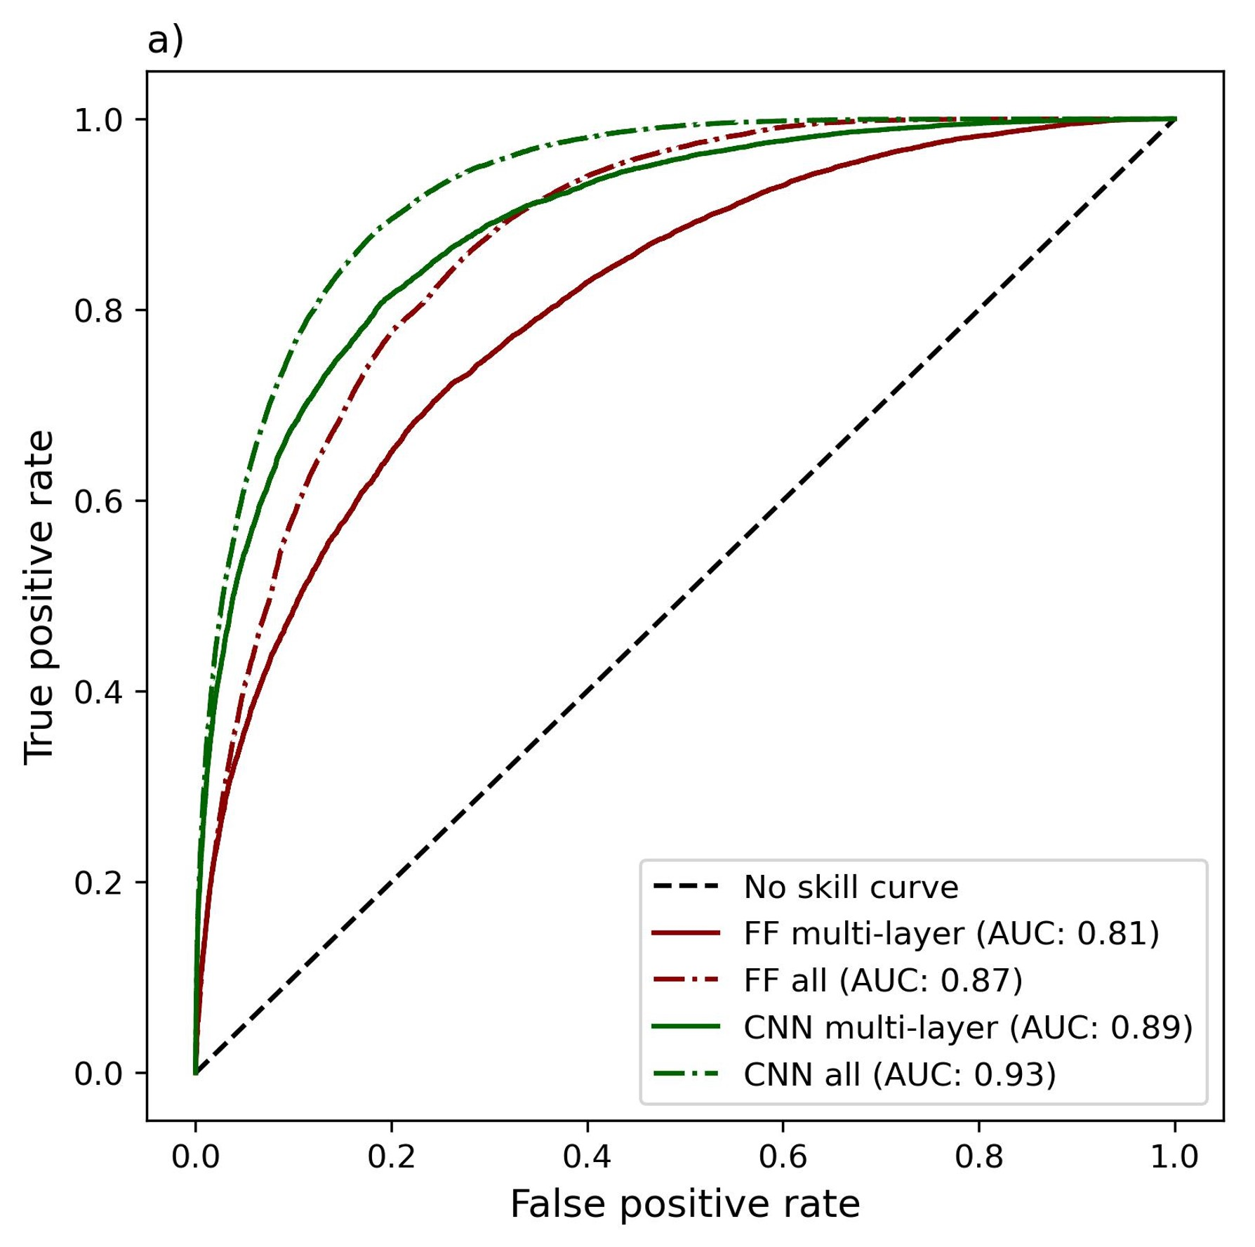
Statistical results
Feed forward: 70 %
Convolutional: 79 %
Convolutional network better
Receiver Operator Curve

Slide 16
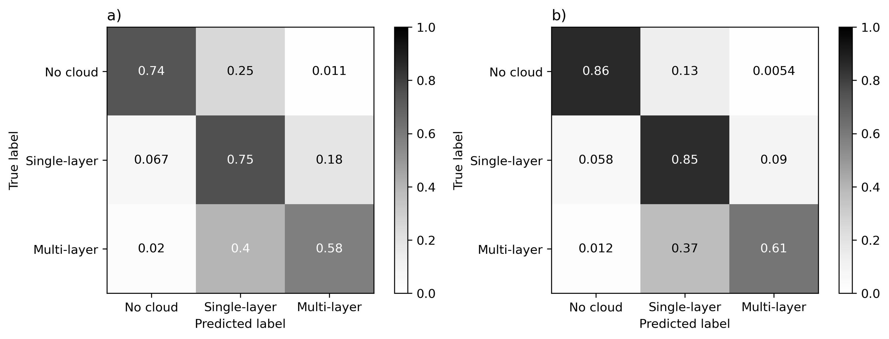
Statistical results – Confusion matrices
Feed Forward
Convolutional
All testing data

Slide 17
Statistical results – Confusion matrices
Feed Forward
Convolutional
All testing data
Convolutional network better

Slide 18
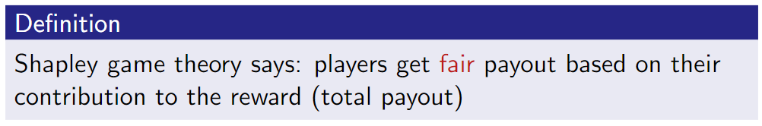
Model interpretability: Shapley game theory
Game = deep learning model Players = features (input variables) Reward = prediction
The “axioms of fairness”
Dummy if a player contributes nothing, they get no payout
Symmetry if two players are interchangeable, they get the same payout
Additivity if a game is comprised of sub-games, players get the sum of their payouts from each sub-game
$∃!φ$ that satisfies (1-3) and distributes the total payout = marginal contribution

Slide 19
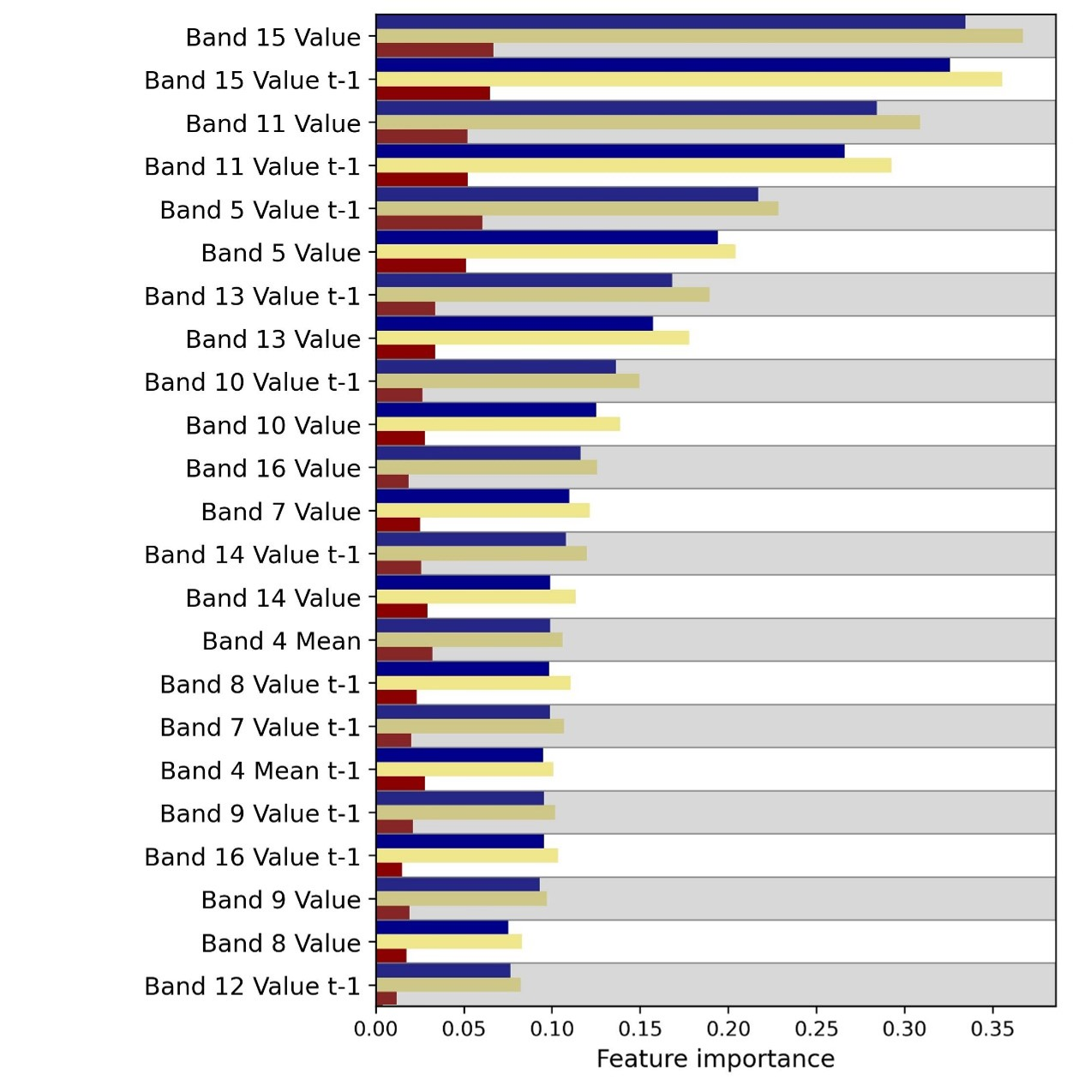
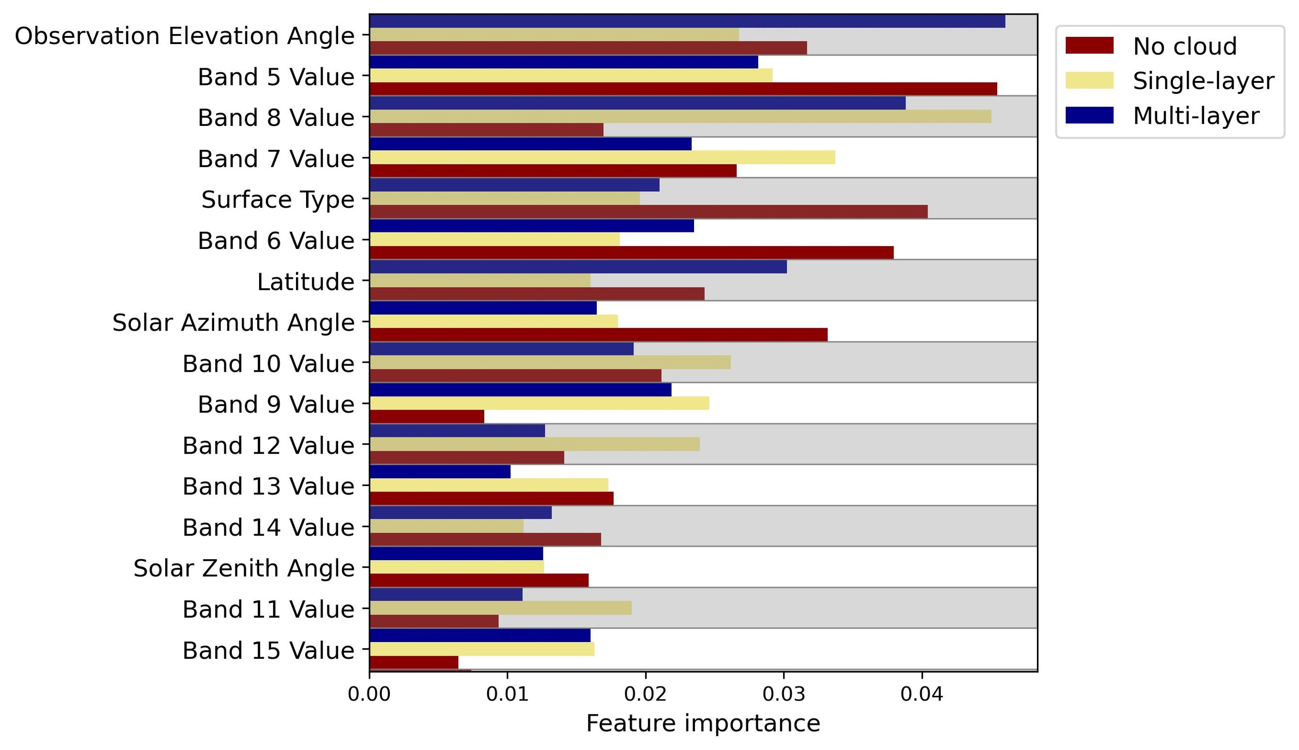
Shapley Additive Explanations (SHAP) (Lundberg and Lee 2017)
Convolutional
Feed forward
Convolutional network better

Slide 20
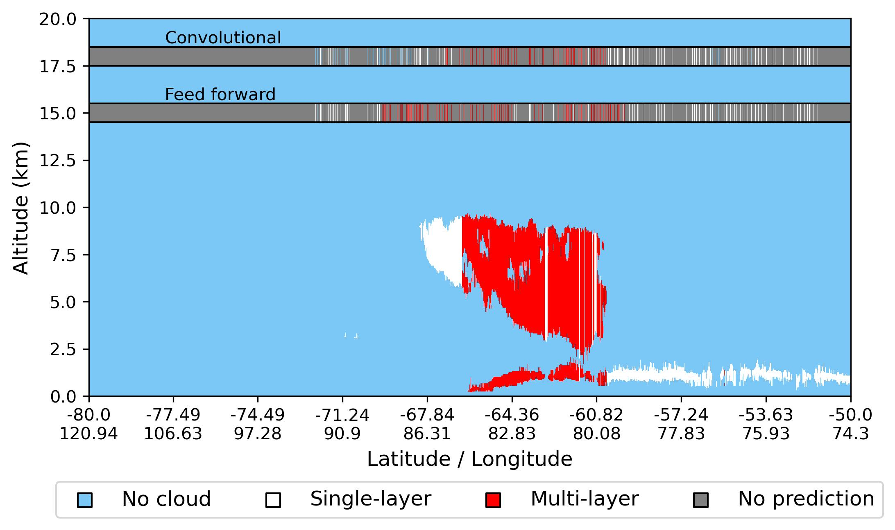
Model performance examples

Slide 21
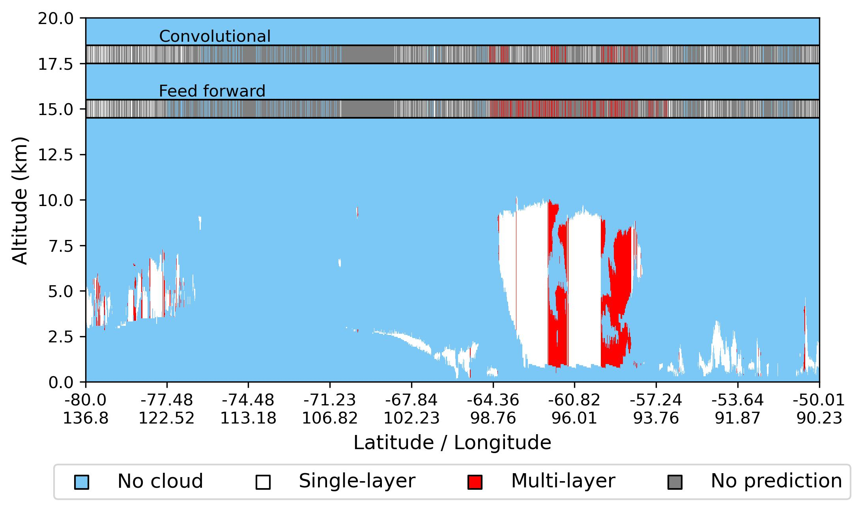
Model performance examples

Slide 22
Conclusion
We have:
Developed two neural network models
Applied Shapley value theory
We found:
Significant improvement
Unprecedented data availability
Convolutional network performed best
Suggests future improvements await
Acknowledgments:
Daniel Robbins and Arathy Aneeshkumar Kurup
ARC Centre of Excellence for Climate Extremes

